Slide 1
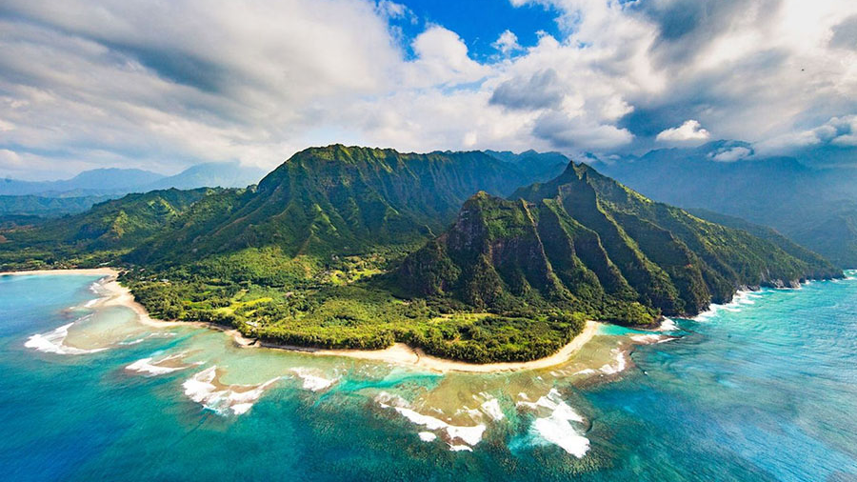
Kauai's Airbnb Landscape: Insights and Analysis
Team Members:
Jose Davila
Diana De los Santos
RAE ANN GREGG
Marc Huerta
Emilia Sanchez
Notes:
Rae Ann

Slide 2
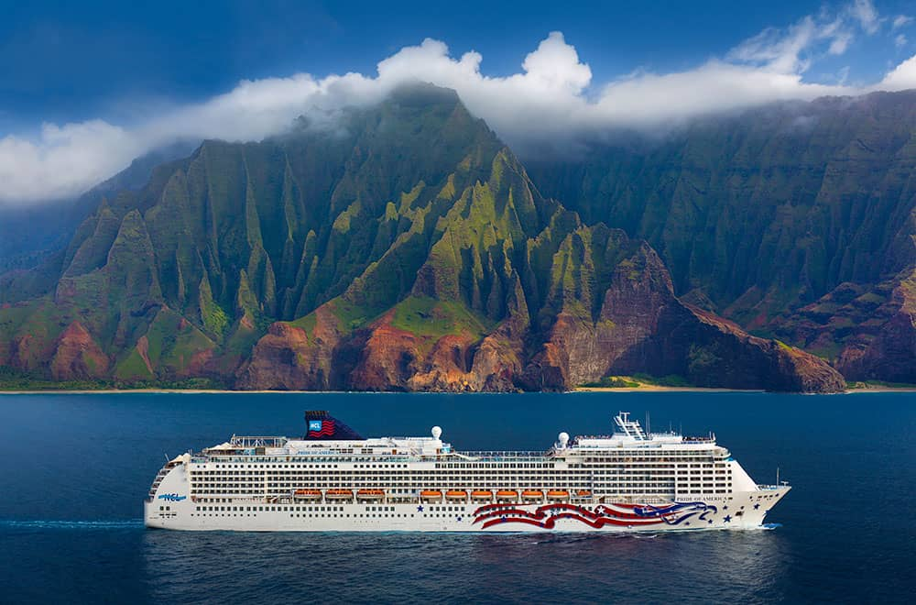
Our Motivation
Our journey began when one of our team members shared their incredible cruise experience in paradise, igniting our curiosity to explore some of the finest destinations. Hawaii immediately came to mind when envisioning a picturesque oceanfront setting and tranquil atmosphere. We researched the top-rated regions to visit in Hawaii, leading us to Kauai—a vibrant community boasting diverse landscapes, from pristine beaches to majestic mountains, which is one of the oldest islands in Hawaii.
With Airbnb as our guide, offering a vast array of accommodation options and insights, we began our virtual exploration. We thoroughly explored Kauai's listings, leveraging Airbnb's intuitive platform to gather comprehensive data on factors such as pricing, location, amenities, and guest reviews. This invaluable resource empowered us to make informed decisions and tailor our analysis to uncover the ideal accommodation choices in Kauai for our vacation.
Notes:
Rae Ann

Slide 3


Kauai Culture
(pronounced: eh koh-moh-my)
A Hawaiian phrase that translates to a sense of belonging, the desire to have people come together and have a sense of community that can be found in Kauai Hawaii!
Kauai is the oldest of the eight main islands. Waves, wind, and water erosion have carved out volcanoes to form what is now known as the Garden Island.
Notes:
Rae Ann

Slide 4
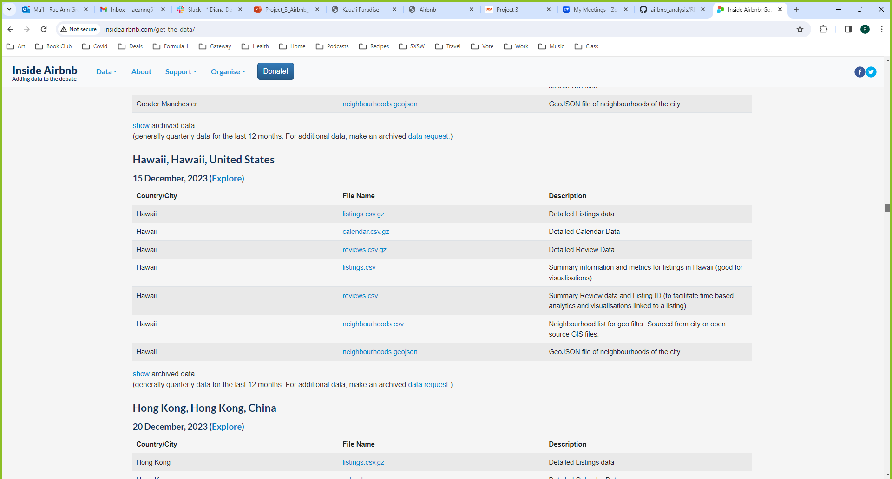
Data Source
Inside Airbnb
http://insideairbnb.com/get-the-data
Notes:
Rae Ann

Slide 5
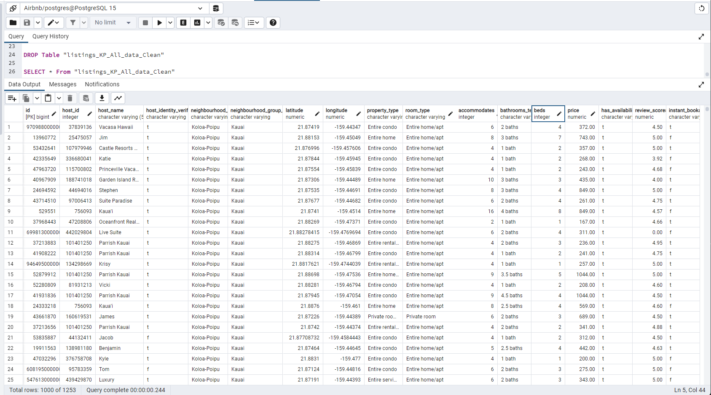
PostgreSQL Table
Notes:
Rae Ann

Slide 6

How Booking Works For Air BNB
Air BNB showcases live booking availability while also giving users an update on peak times to book.
Popular dates are calculated based on real-time searches for stays, plus the number of available listings, so they can change frequently. Air BNB tools predict popular dates up to 10 weeks in advance, becoming more accurate as the date approaches
Notes:
Emilia

Slide 7
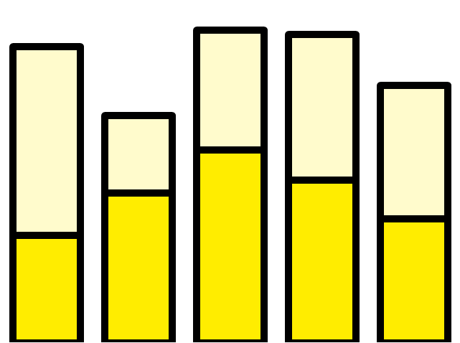
Total Air BNB Listings 2021
12.7M
The following Airbnb statistics show the breakdown of total listings by region.
Global markets
Africa
North America
Europe
Asia Pacific
Latin America
32,597 listings for Air BNB in Hawaii, the island state of Hawaii has the highest Airbnb density out of all U.S. cities and regions analyzed by InsideAirbnb data source.
.3
2.5
4.8
3.2
1.7
http://insideairbnb.com/
Notes:
Emilia

Slide 8
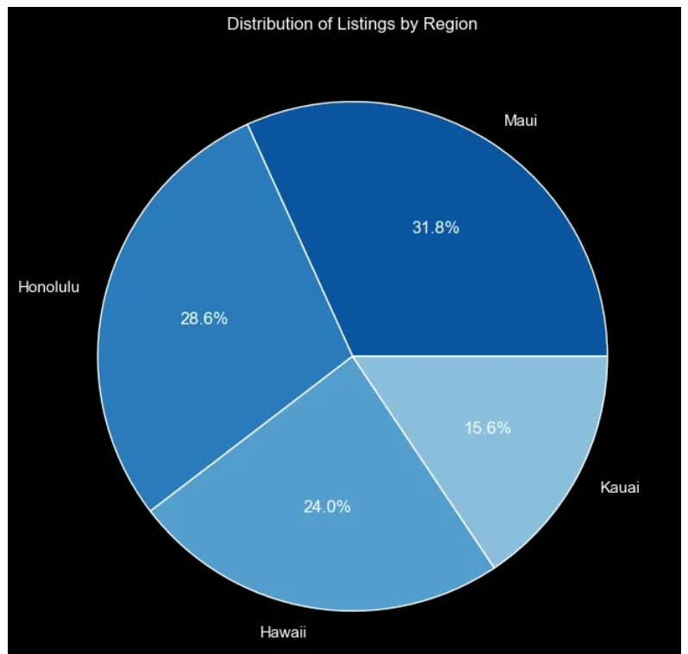
Distribution of listings by region
Hawaii consists of several major islands, each with its own unique characteristics and attractions. These islands include Oahu, Maui, Big Island (Hawaii), Kauai, Molokai, and Lanai.
https://medium.com/@mathyou/exploratory-data-analysis-of-hawaii-airbnb-python-project-f213bdd947dc

Slide 9

How do you decide who to book with on Air BNB?
One consideration is looking at a side-by-side comparison on the differences a super host vs a regular host.
Notes:
Emilia

Slide 10
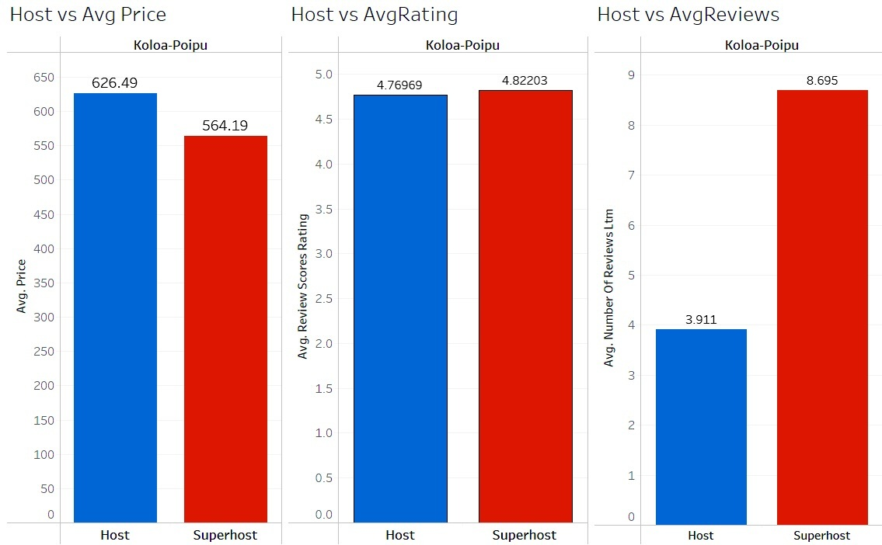
What Makes a Super Host Stand Out?
Every 3 months, each host is evaluated on their hospitality they must meet all the following criteria—they’re highly rated, experienced, reliable, and responsive.
Maintains a remarkable 4.8+ overall rating.
Boasts a minimum of 10 stays, showcasing extensive hosting experience.
Demonstrates reliability with a cancellation rate of less than 1%.
Maintains a 90% response rate, ensuring swift assistance to guests.
https://public.tableau.com/views/SuperHost_1/Dashboard1?:language=en-US&publish=yes&:display_count=n&:origin=viz_share_link
https://www.airbnb.com/d/superhost-guest#:~:text=Being%20an%20Airbnb%20Superhost%20is,and%20often%20exceeding%2C%20guest%20expectations
Notes:
Diana -

Slide 11
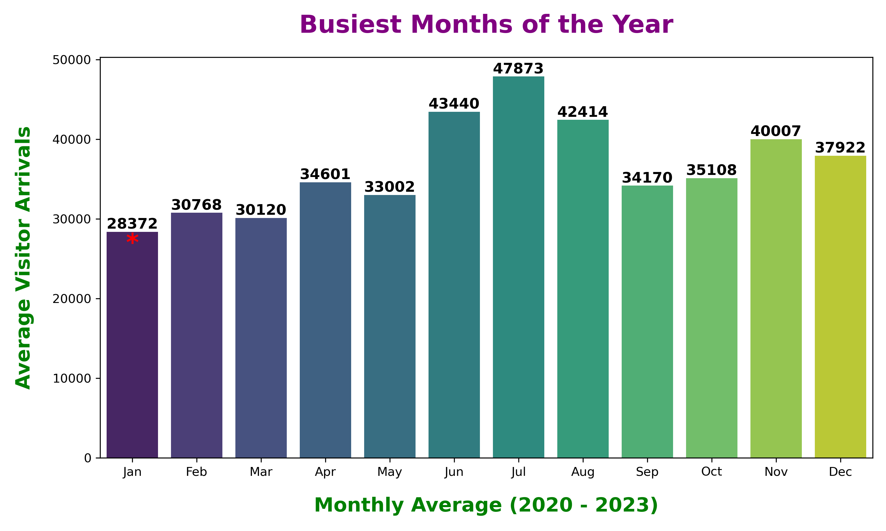
http://insideairbnb.com/get-the-data/
Notes:
Diana - The optimal period for visiting Hawaii spans from March to September, marked by the highest temperatures and minimal rainfall. According to insights from Hawaii Tourism, July stands out as the busiest arrival month, while January takes the lead as the quieter period for visitors.

Slide 12
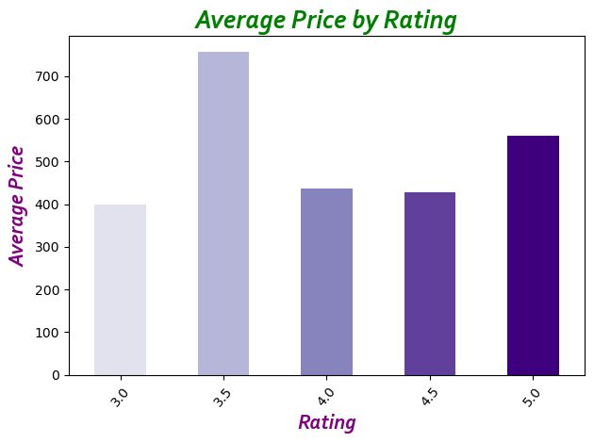
https://www.budgetyourtrip.com/united-states-of-america/kauai
Notes:
Marc

Slide 13

Kauai – Webpage Presentation

Slide 14
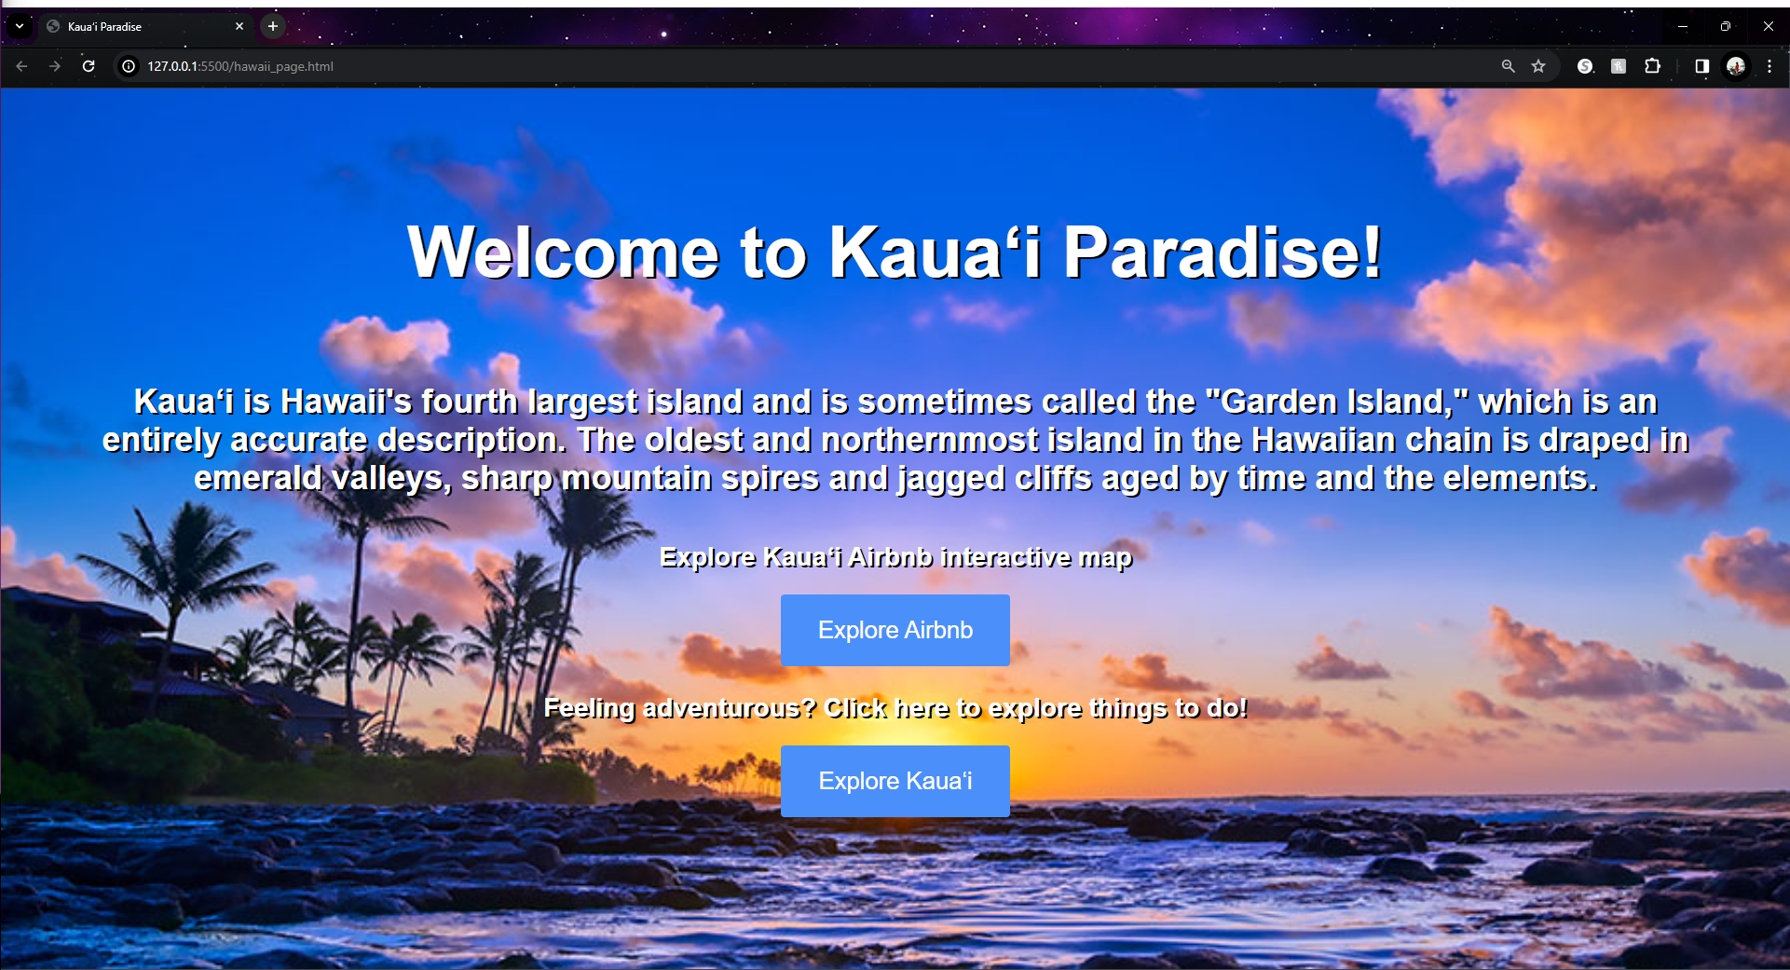

Slide 15
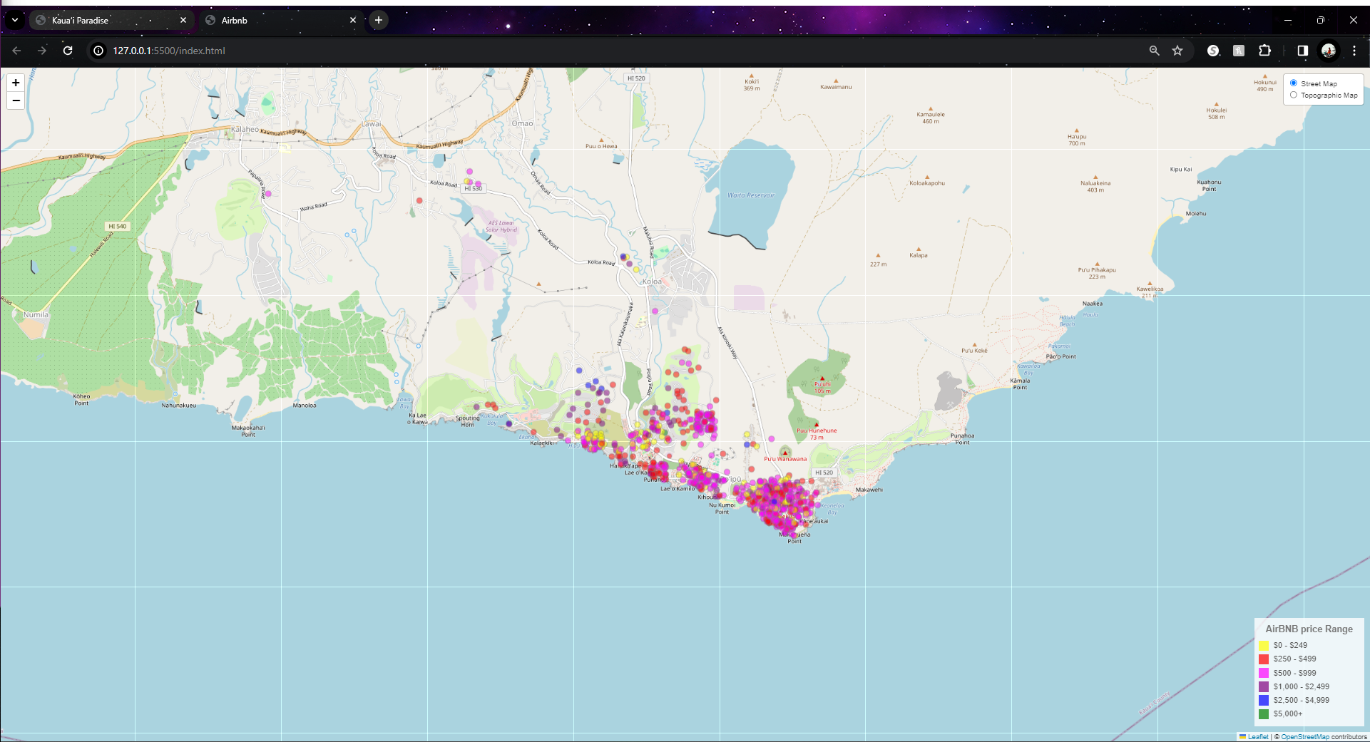

Slide 16
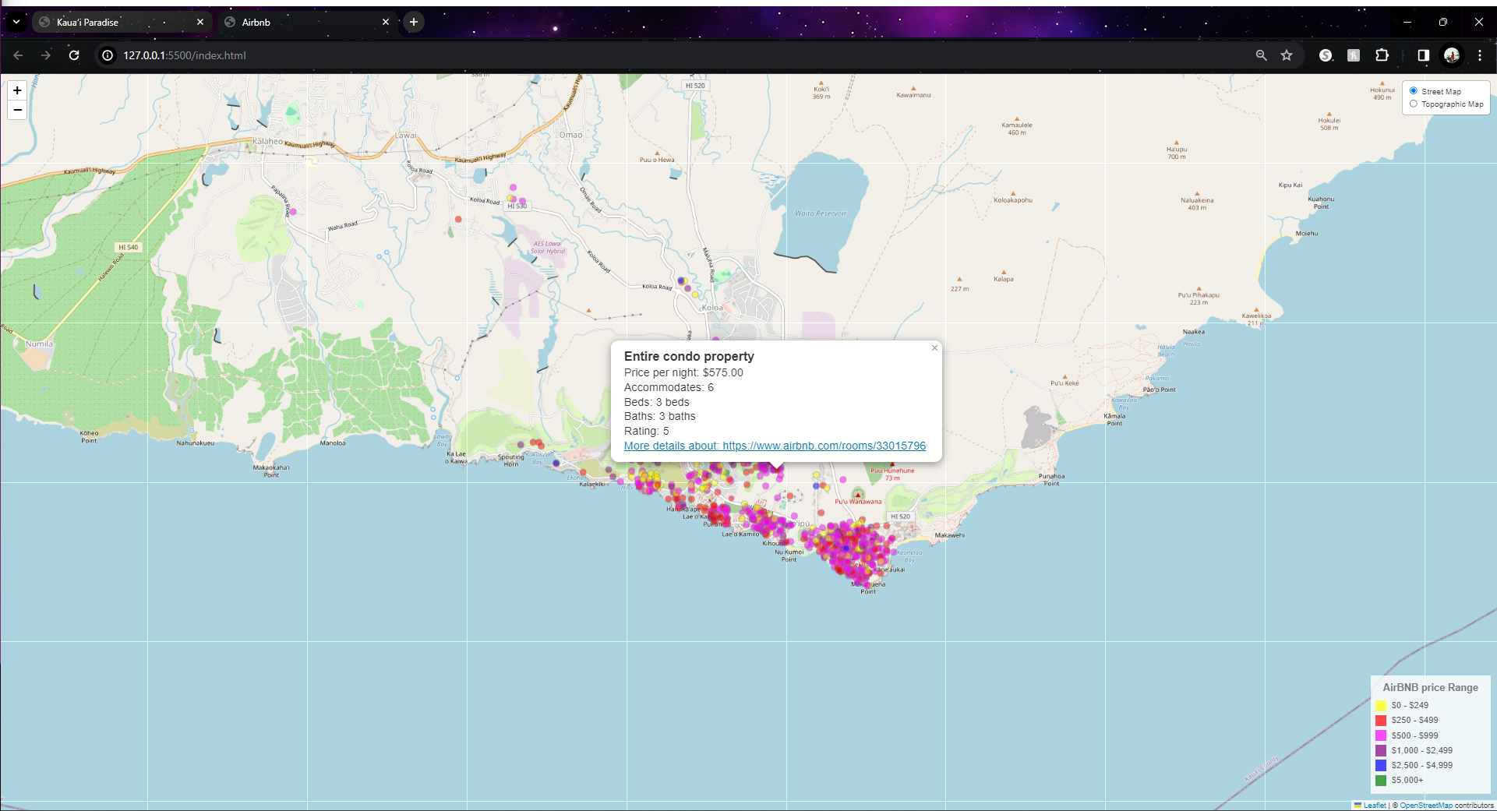

Slide 17
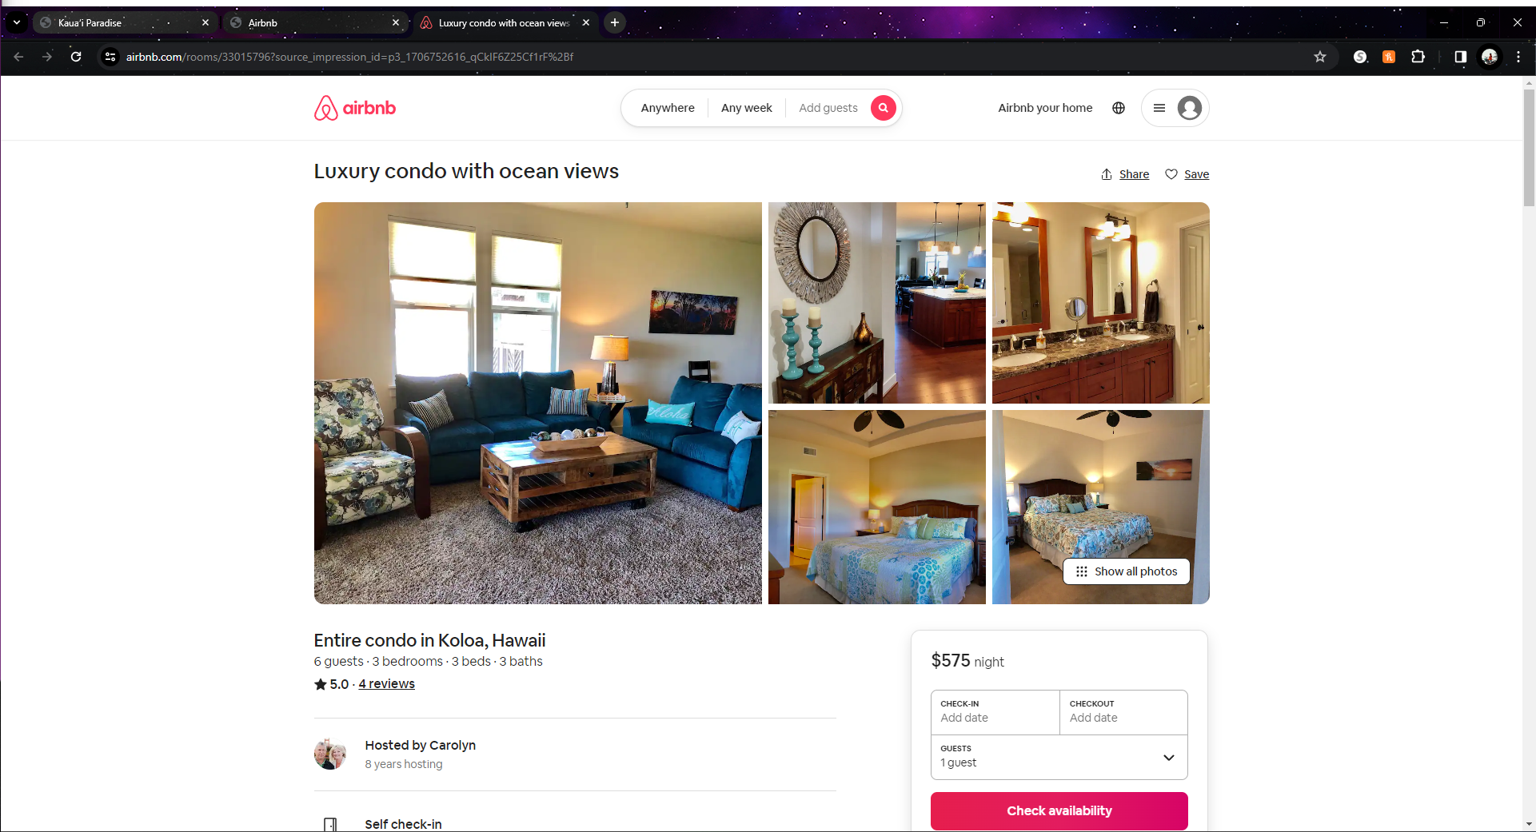

Slide 18
